Slide 1

Shapely A Python Library

Slide 2
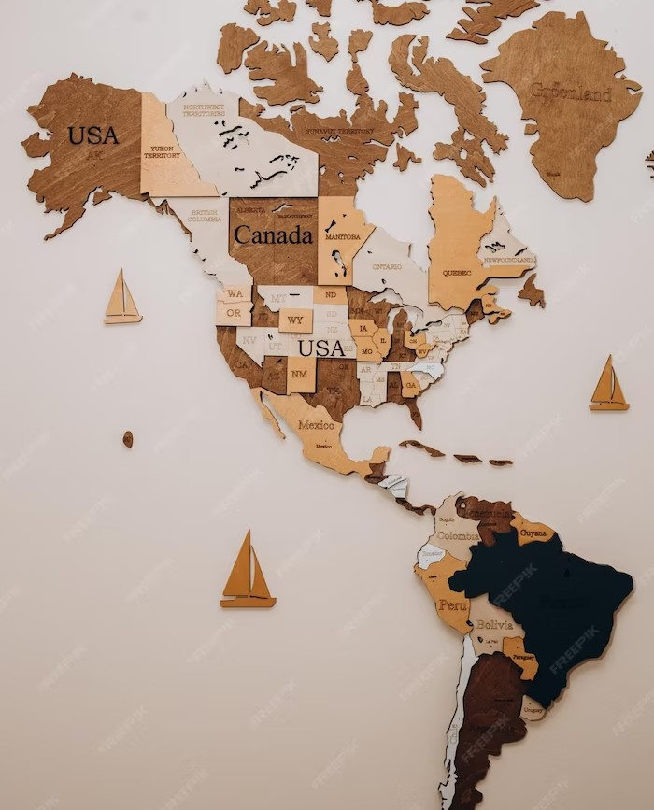
What is Shapely
Shapely is a Python library that helps you work with and manipulate geometric shapes, like points, lines, and polygons.It provides tools to perform operations like checking if two shapes overlap, finding the distance between points, or creating new shapes by combining or changing existing ones. Shapely is often used in geospatial applications

Slide 3
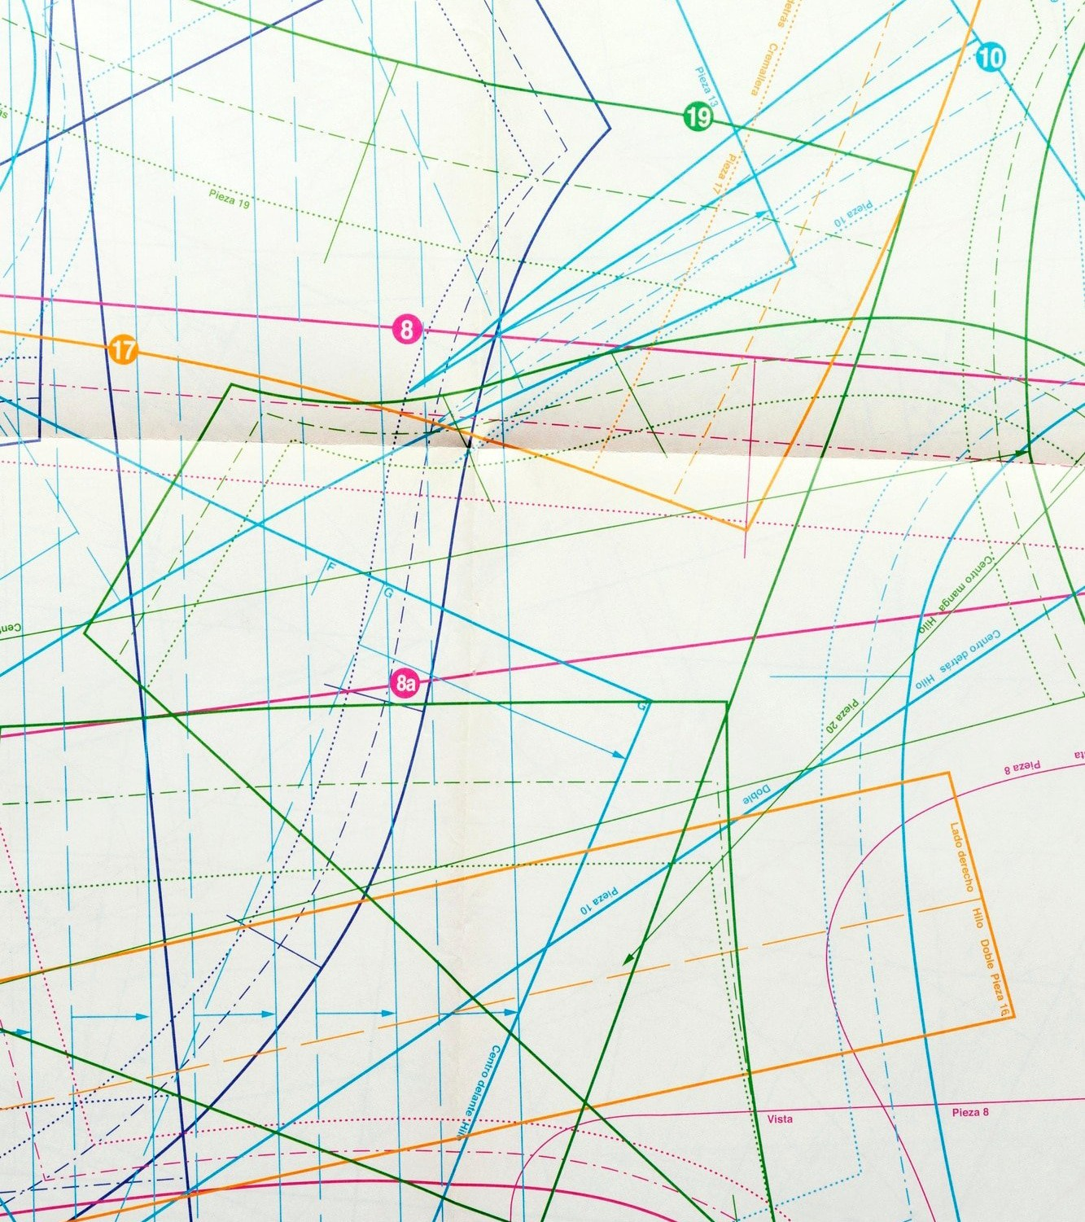
Geometric Objects
Shapely provides several geometric objects that you can use to represent points, lines, polygons, and other spatial features. These objects have attributes such as area, length, and bounds, and methods such as buffer, centroid. You can create and manipulate these objects using Shapely.

Slide 4
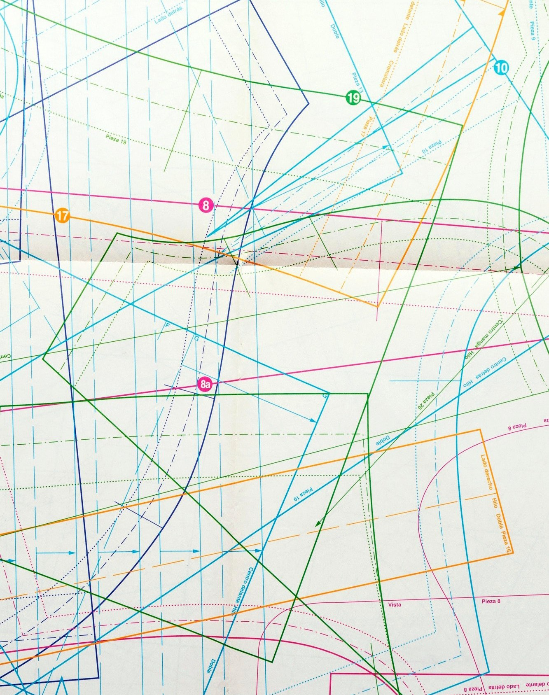
Spatial Analysis
Shapely provides several functions for spatial analysis tasks, such as overlaying, buffering, and clipping. These functions take geometric objects as input and return new geometric objects as output. You can use these functions to analyze and manipulate spatial data in Python.

Slide 5

Overlaying
Overlaying is a spatial analysis task that involves combining two or more geometric objects to create a new one. Shapely provides several functions for overlaying, such as union, intersection, and difference. You can use these functions to combine and compare spatial data in Python.

Slide 6

Buffering
Buffering is a spatial analysis task that involves creating a buffer around a geometric object.
Shapely provides a buffer function that takes a distance and a resolution as input and returns a new geometric object as output.
You can use this function to create
and analyze buffers in Python.

Slide 7

Clipping
Clipping is a spatial analysis task that involves cutting a geometric object using another geometric object as a clipper. Shapely provides a clip function that takes two geometric objects as input and returns a new geometric object as output. You can use this function to cut and analyze spatial data in Python.

Slide 8
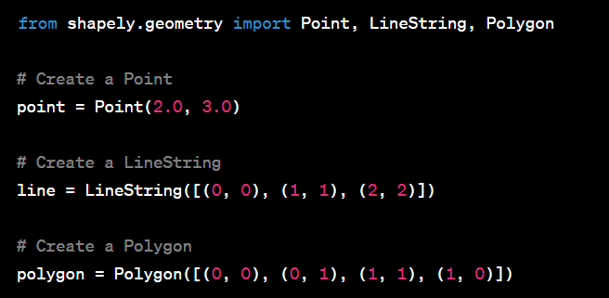
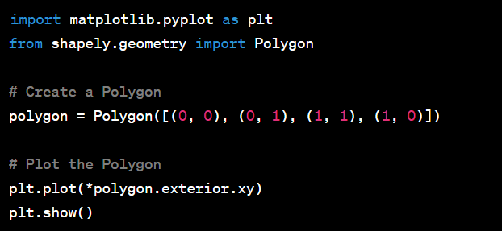
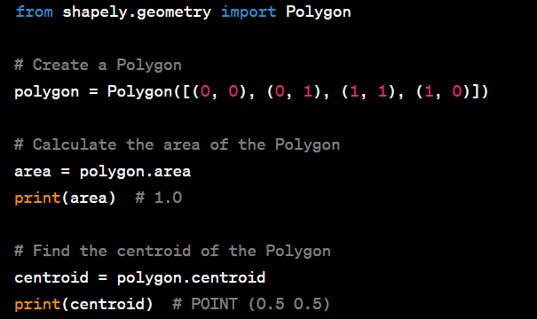
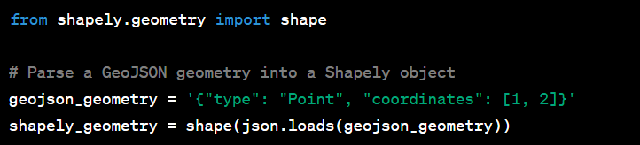
IMPLEMENTATION & VISUALIZATION

Slide 9
Conclusion
Shapely is a powerful Python library for spatial analysis tasks.It provides an easy-to-use interface to perform and analyze geometric operations. With Shapely, you can create, manipulate, and analyze geometric objects in a Pythonic way. It is a well-documented and open source library that is widely used in the geospatial community.

